Slide 1



Amazon Web Services
(AWS)
4. EC2 Instance Storage

Slide 2
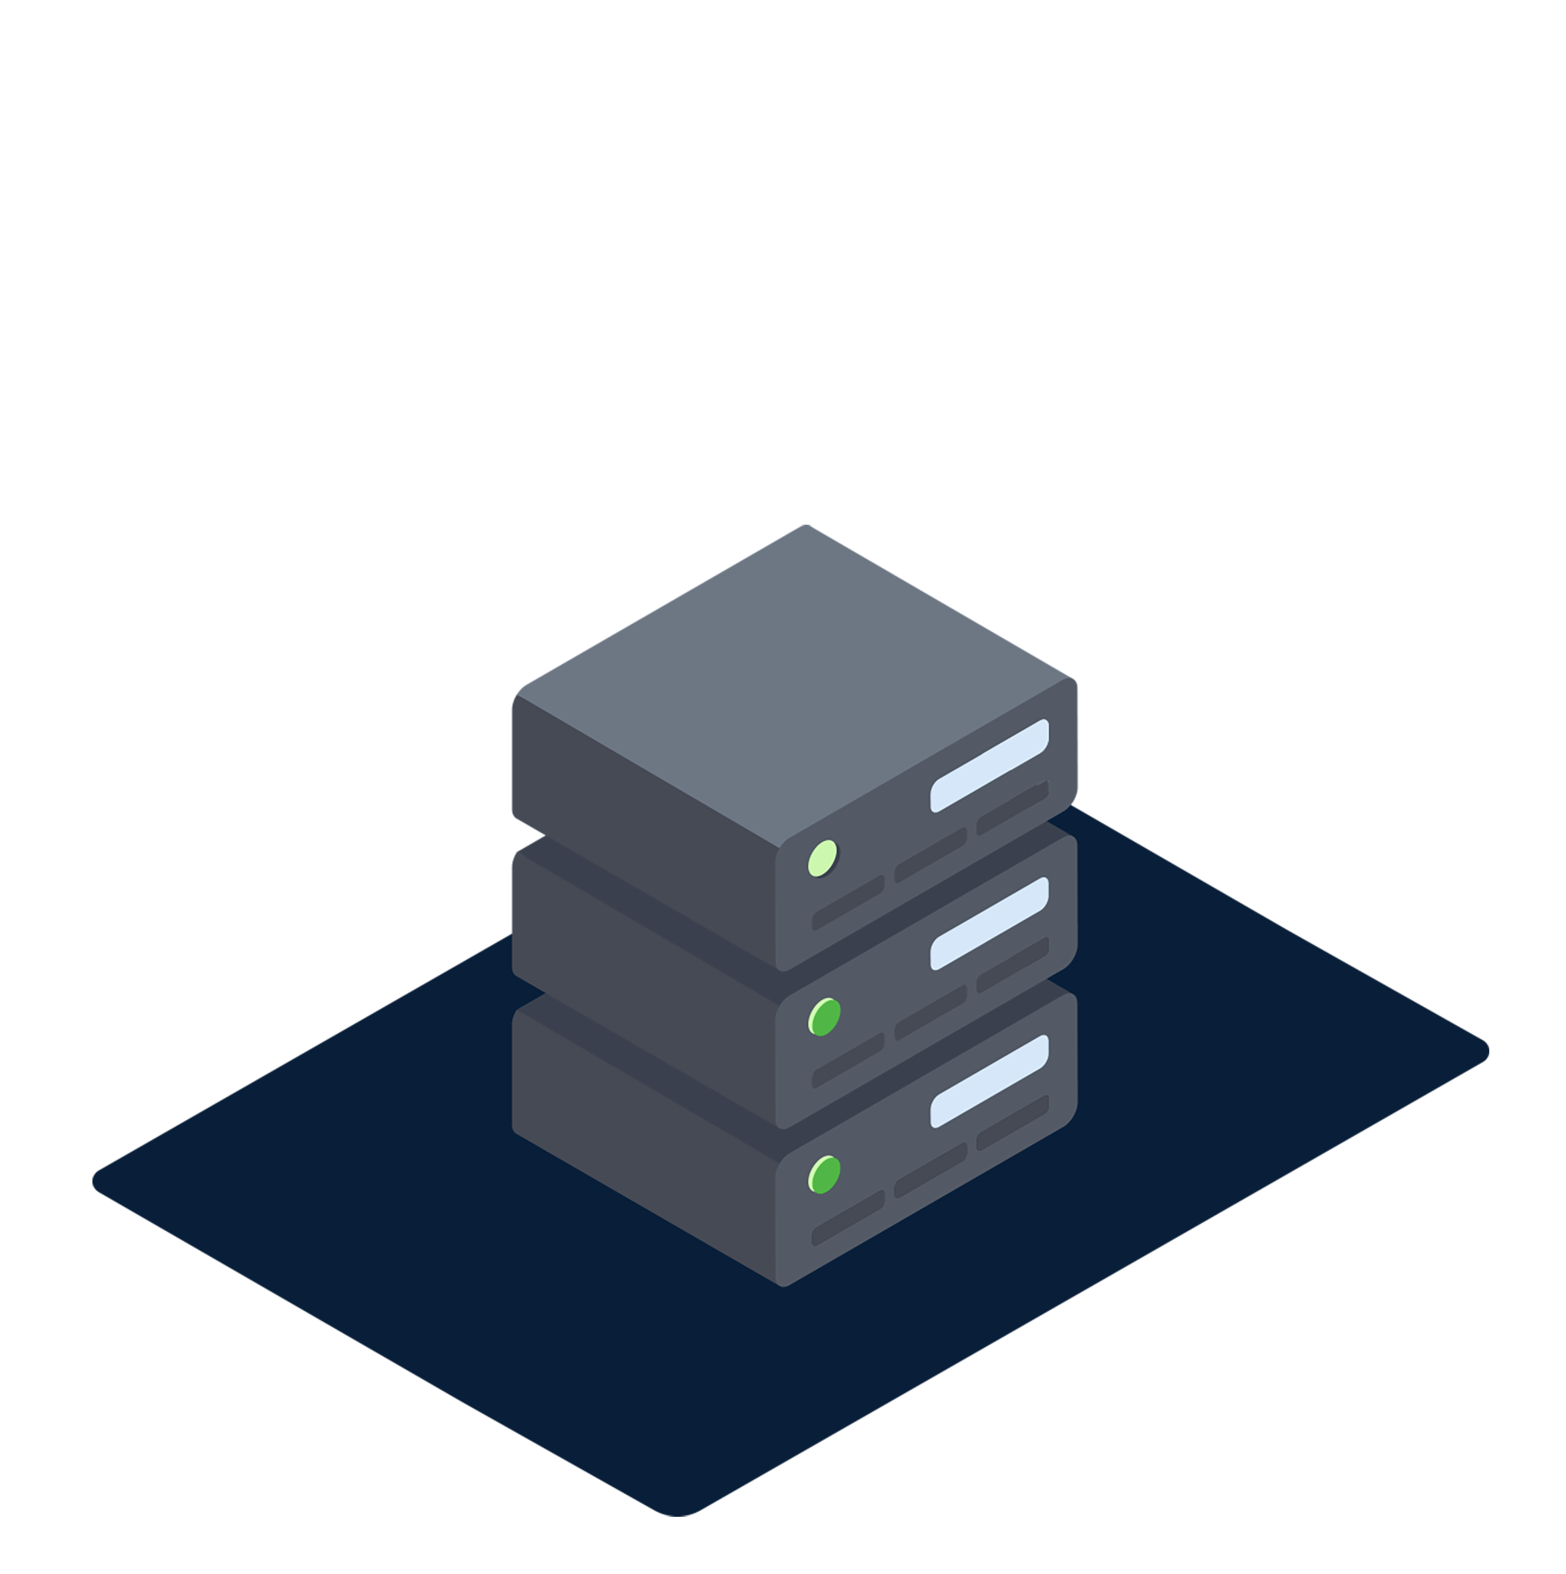
EBS Overview

Slide 3
What is EBS Volume
An EBS (Elastic Block Store) volume is a network drive you can attach to your instances while they run
It allows your instances to persist data, even after their termination
They can only be mounted to one instance at a time
They are bound to specific availability zone
Analogy: think of them as a “network USB stick”
Free tier: 30Gb of free EBS storage of type General Purpose (SSD) or Magnetic per month

Slide 4
EBS Volume
It’s a network drive (i.e. not a physical drive)
  It uses the network to communicate the instance, which means there might be a bit of latency
  It can be detached from EC2 instance and attached to another one quickly
It’s locked to an Availability zone (AZ)
  An EBS Volume in us-east-1 a cannot be attached to us-east-1 b
  To move a volume across, you first need to snapshot it
Have a provisioned capacity (size in GBs, and IOPS)
  You get billed for all the provisioned capacity
  You can increase the capacity of the drive over time

Slide 5


EBS Volume - Example
US-EAST-1A
US-EAST-1B
Instance
Instance
Instance
EBS
(10Gb)
EBS
(100Gb)
EBS
(50Gb)
EBS
(50Gb)
EBS
(10Gb)
Unattached

Slide 6
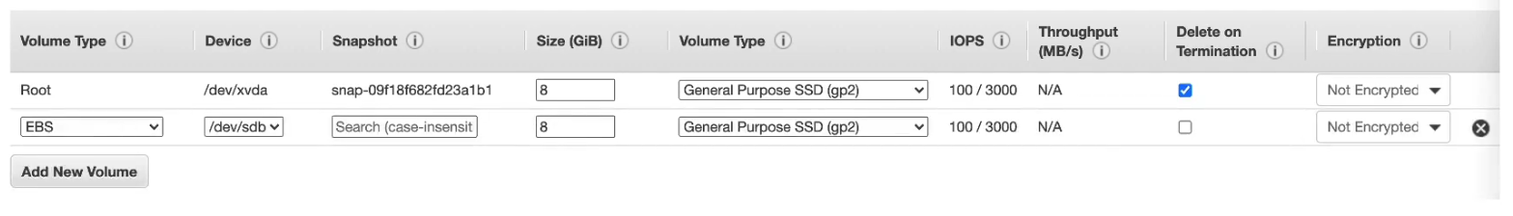
EBS-Delete on Termination
Controls the EBS behavior when an EC2 instance terminates
  By default, the root EBS volume is deleted (attribute enabled)
  By default, any other attached EBS volume is not deleted (attribute disable)

Slide 7

EBS Snapshots
Make a backup (snapshot) of your EBS volume at a point in time
Not necessary to detach volume to do snapshot, but recommended
Can copy snapshots across AZ or Region
US-EAST-1A
US-EAST-1B
Instance
Instance
Snapshot
Restore
EBS
(50Gb)
EBS
Snapshot
EBS
(50Gb)

Slide 8
AMI Overview
AMI = Amazon Machine Image
AMI are customization of an EC2 instance
  You add your own software, configuration, operating system, monitoring…
  Faster boot / configuration time because all your software is pre-packaged
AMI are built for a specific region (and can be copied across regions)
You can launch EC2 instances from:
  A public AMI: AWS provided
  Your own AMI: you make and maintain them yourself
  An AWS Marketplace AMI: an AMI someone else made (and potentially sells)

Slide 9

AMI Process (from an EC2 Instance)
Start an EC2 instance and customize it
Stop the instance (for data integrity)
Build an AMI – this also create EBS snapshots
Lunch instances from other AMIs
US-EAST-1A
US-EAST-1B
Create AMI
Lunch from AMI
Instance
Custom
AMI
Instance

Slide 10

EC2 Image Builder
Used to automate the creation of virtual Machines or container images
Automate the creation, maintain, validate and test the EC2 AMIs
Can be run on a schedule (weekly, whenever packages update, etc.)
Free service (only pay for the underline resources)
Build Components applied (customize software on instance)
Test suite is run
(Is the AMI working, secure?)
Create
Create
AMI is distributed
(can be multiple regions)
EC2 Image Builder
Builder EC2 Instance
New AMI
Instance

Slide 11
EC2 Instance Store
EBS volumes are network drives with good but “limited” performance
If you need a high-performance hardware disk, use EC2 instance store
Better I/O performance
EC2 instance store lose their storage if they’re stopped (ephemeral)
Good for buffer / cache / scratch data / temporary content
Risk of data loss if hardware fails
Backup and replication are your responsibility

Slide 12
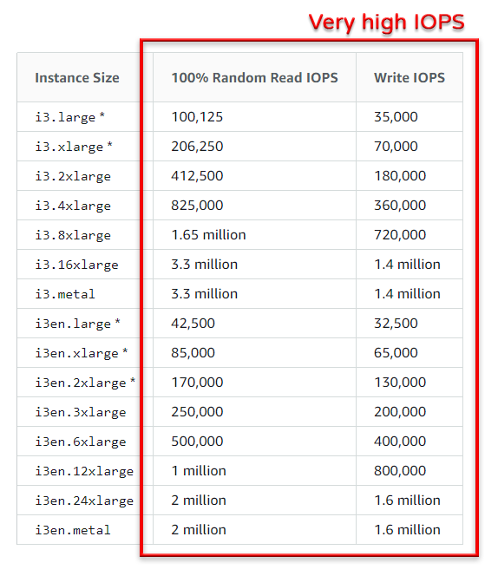
EC2 Instance Store

Slide 13
EFS – Elastic File System
Managed NFS (network file system) that can be mounted on hundreds (100s) of EC2
EFS works with Linux EC2 instances in multi-AZ
Highly available, scalable, expensive (3x gp2), pay per use, no capacity planning
EC2
us-east-1a
EC2
us-east-1b
EC2
us-east-1c
Security Group
EFS

Slide 14






EBS vs EFS
Availability Zone 1
Availability Zone 2
Availability Zone 1
Availability Zone 2
EFS
Mount
Target
EFS
Mount
Target
EBS
EBS
Snapshot
Restore
EBS
Snapshot
EFS

Slide 15


EFS Infrequent Access (EFS-IA)
Storage class that is cost-optimized for files not access every day
Up to 92% lower cost compared to EFS Standard
EFS will automatically move your files to EFS-IA based on the last time they were accessed
Enable EFS-IA with a Lifecycle Policy
Example: move files that are not accessed for 60 days to EFS-IA
Transparent to the applications accessing EFS
No access for 60 days
EFS Standard
move
Lifecycle Policy
EFS-IA
Amazon EFS File System

Slide 16


Amazon FSx for Windows File Server
Region
A fully managed, highly reliable, and scalable Windows native shared file system
Built on Windows File Server
Support SMB protocol & Windows NTFS
Integrated with Microsoft Active Directory
Can be accessed from AWS or your on premise infrastructure
Availability Zone 1
Availability Zone 2
EC2 Instance
FSx for windows
File Server
FSx for windows
File Server
\\fs-012345abcd0.example.com\share
Over SMB
Corporate
data center
Windows Client

Slide 17




Amazon FSx for Lustre
A fully managed, high-performance, scalable file storage for High Performance Computing (HPC)
The name ‘ Luster ‘ is derived from “Linux” and “Cluster”
Machine learning, analytics, video processing, financial modeling,…
Scale up to 100s GB/s, millions of IOPS, sub-ms latencies
Region
Corporate data center
Amazon S3
Link
Access your data
Amazon FSx for Lustre
Server
Compute instances
Access your data

